Slide 1
Business development for cast India 2025 - 2026

Slide 2
Competetors

Slide 3
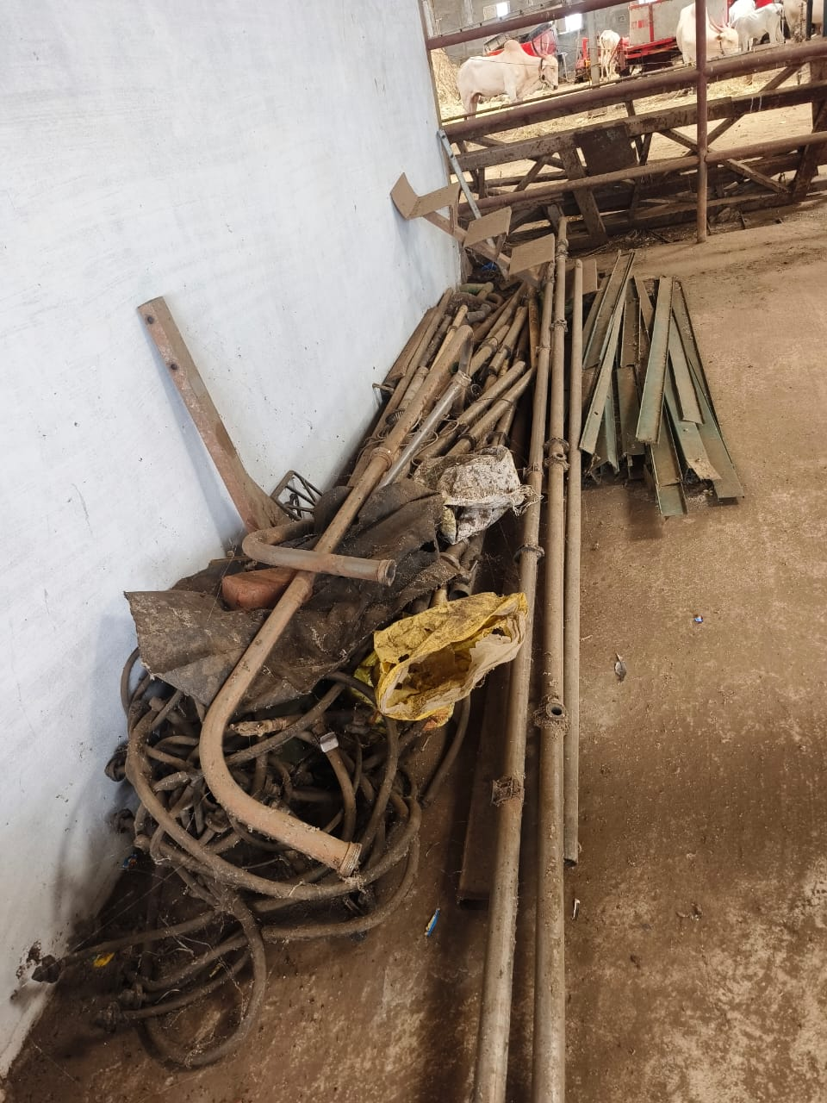
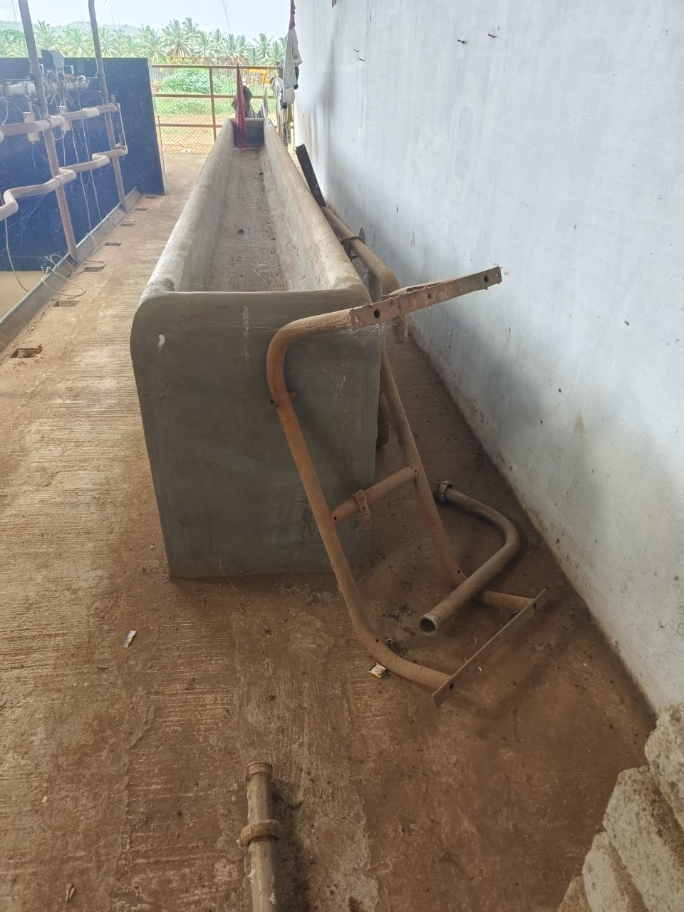
Previous condition

Slide 4
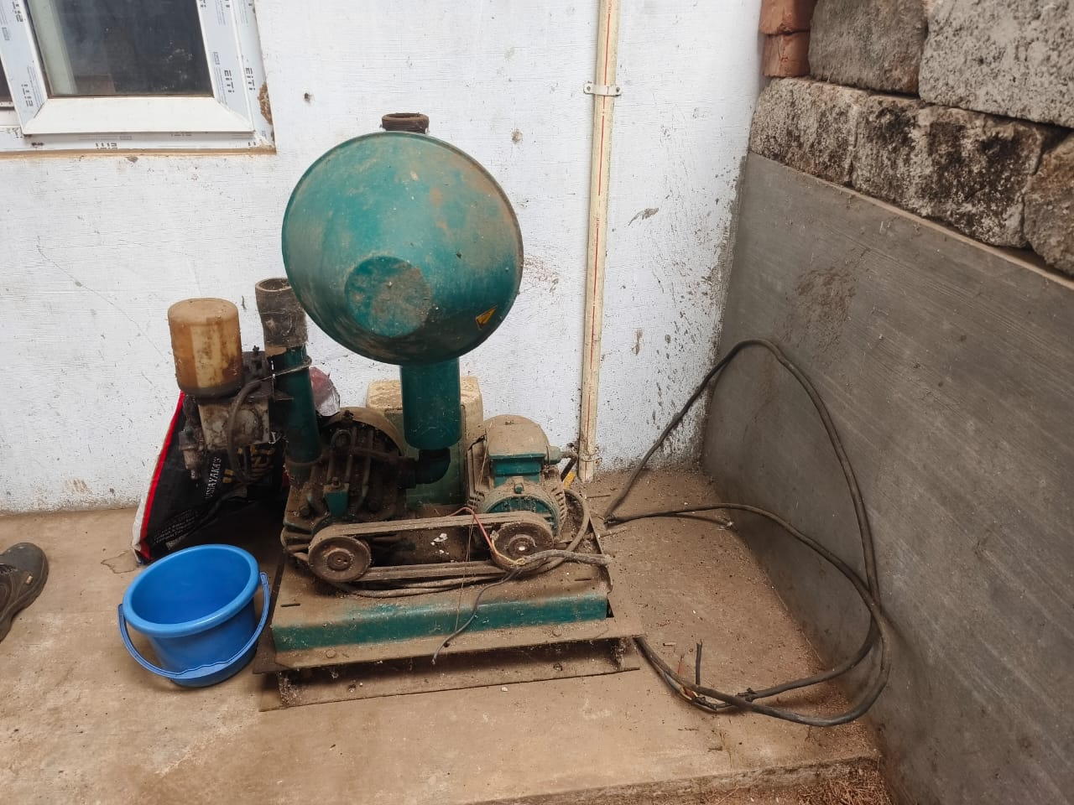
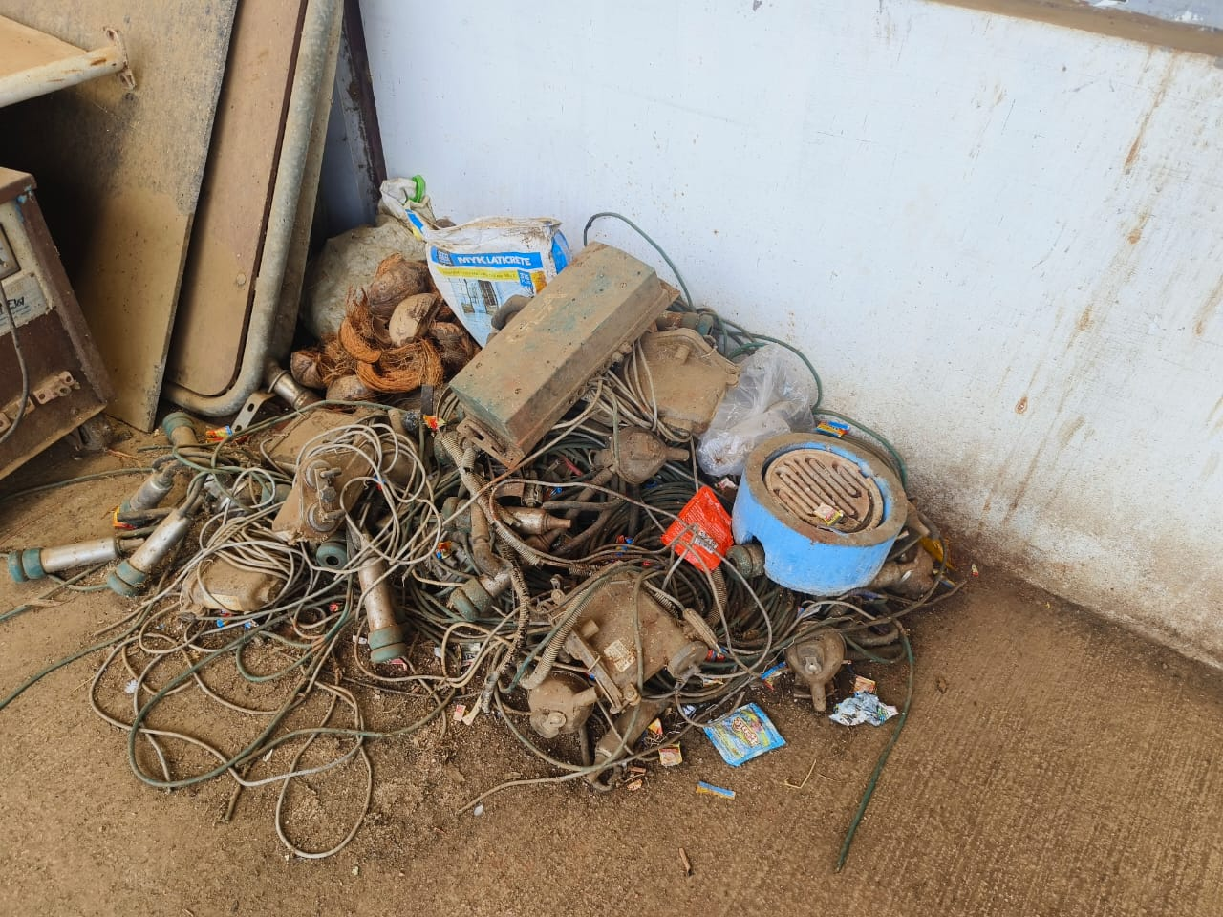
Previous condition

Slide 5
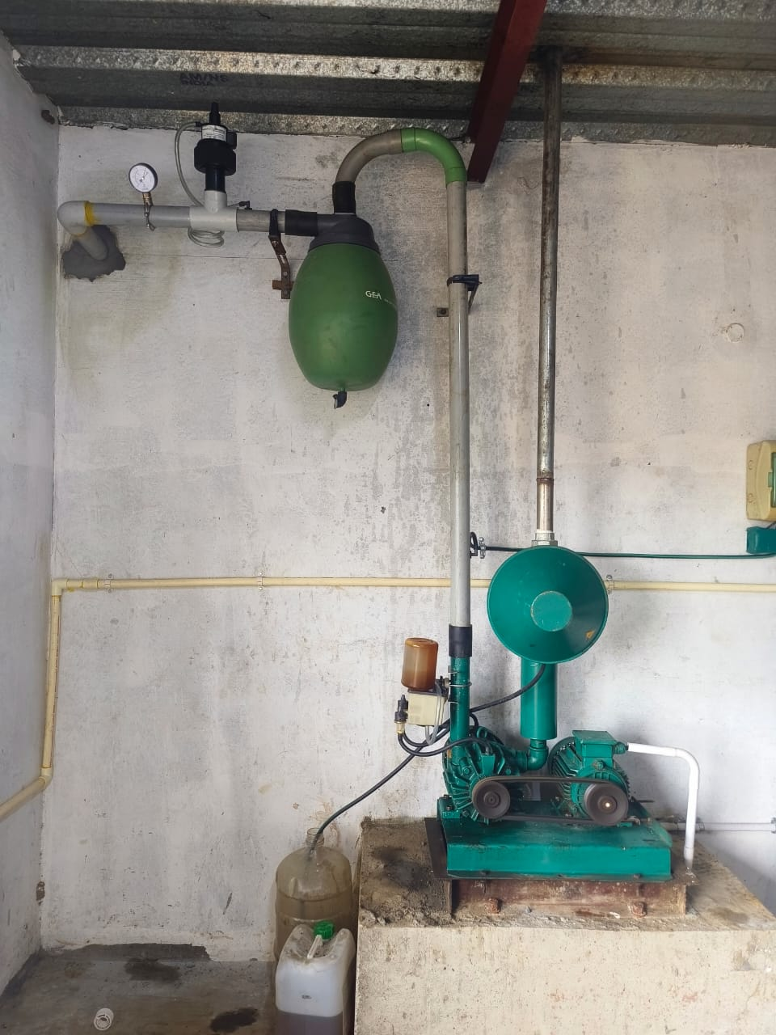
Current condition
Vacuum pump Installed with vacuum regulator and vacuum guage

Slide 6
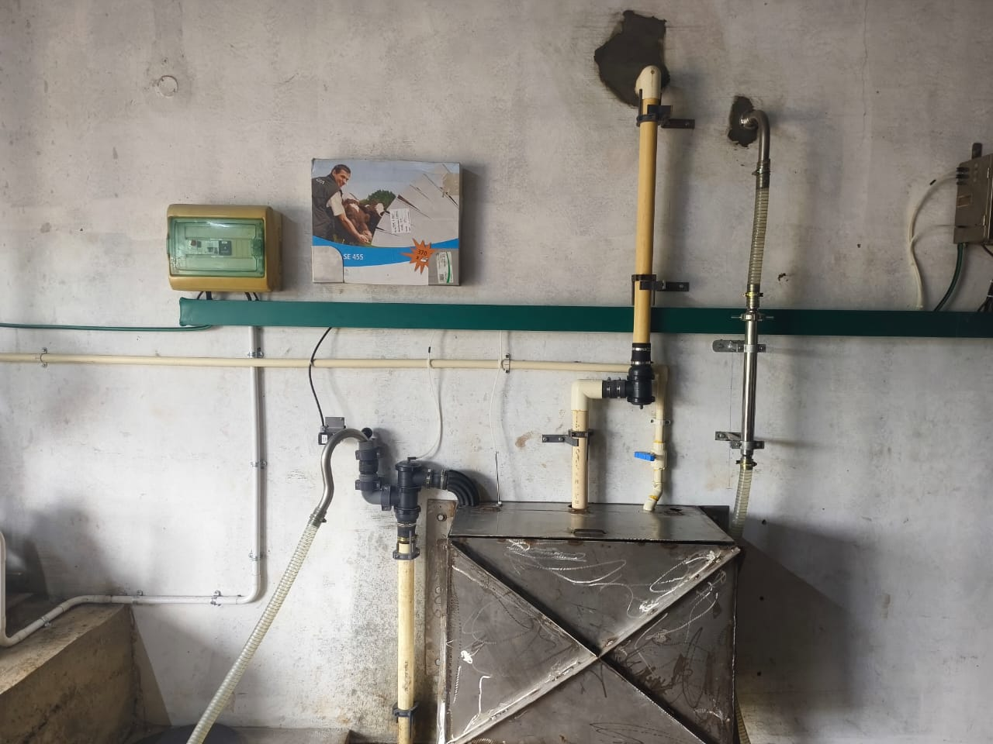
Current condition
Automatic CIP System Installed completely

Slide 7
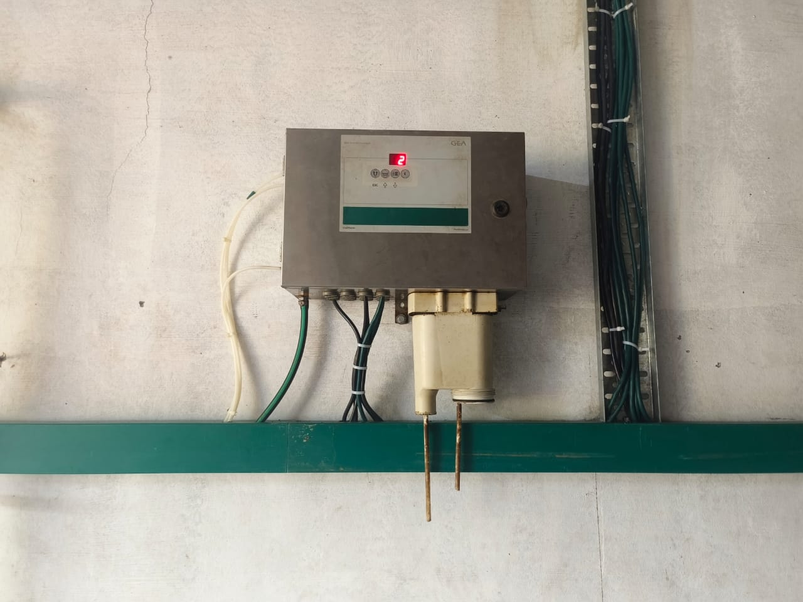
Current condition
Sinetherm Installed successfully and working fine

Slide 8
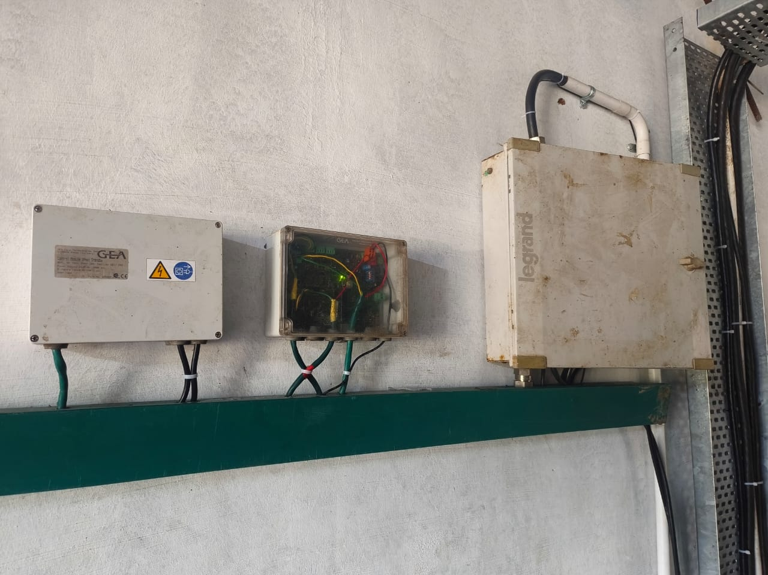
Current condition
DB Power supply Dpnet Standby and DMS 21 Gateway installed successfully and working fine

Slide 9
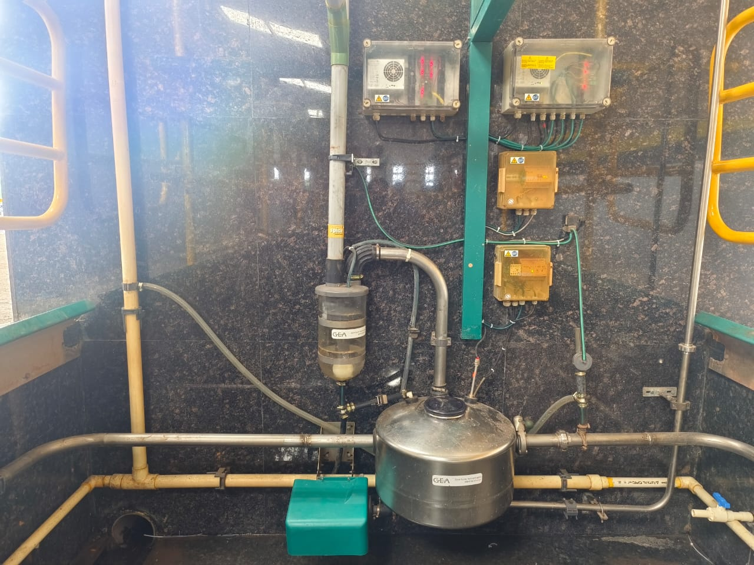
Current condition
Mik transfer system installed successfully and working fine

Slide 10
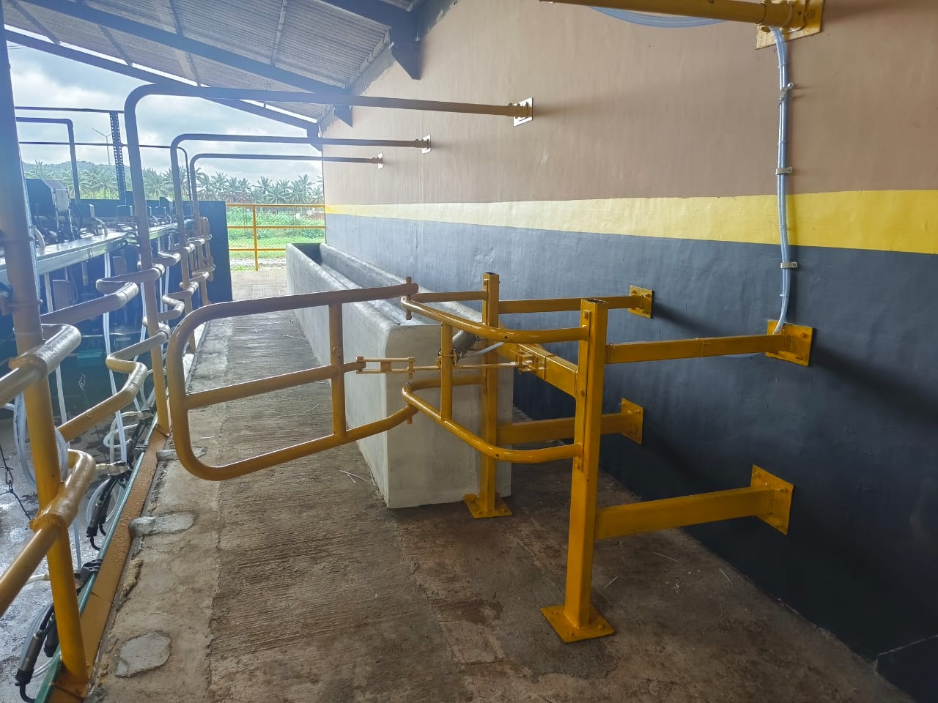
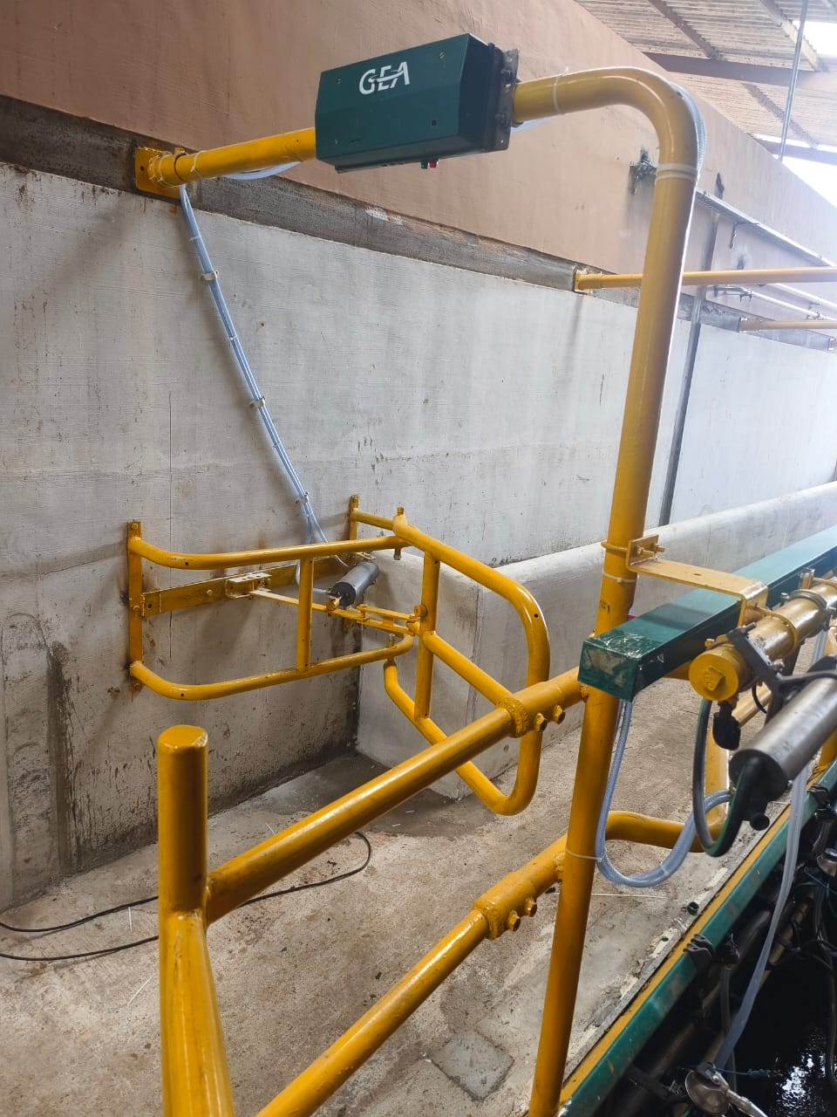
Current condition
Entry gate and exit gates are installed successfully and working fine

Slide 11
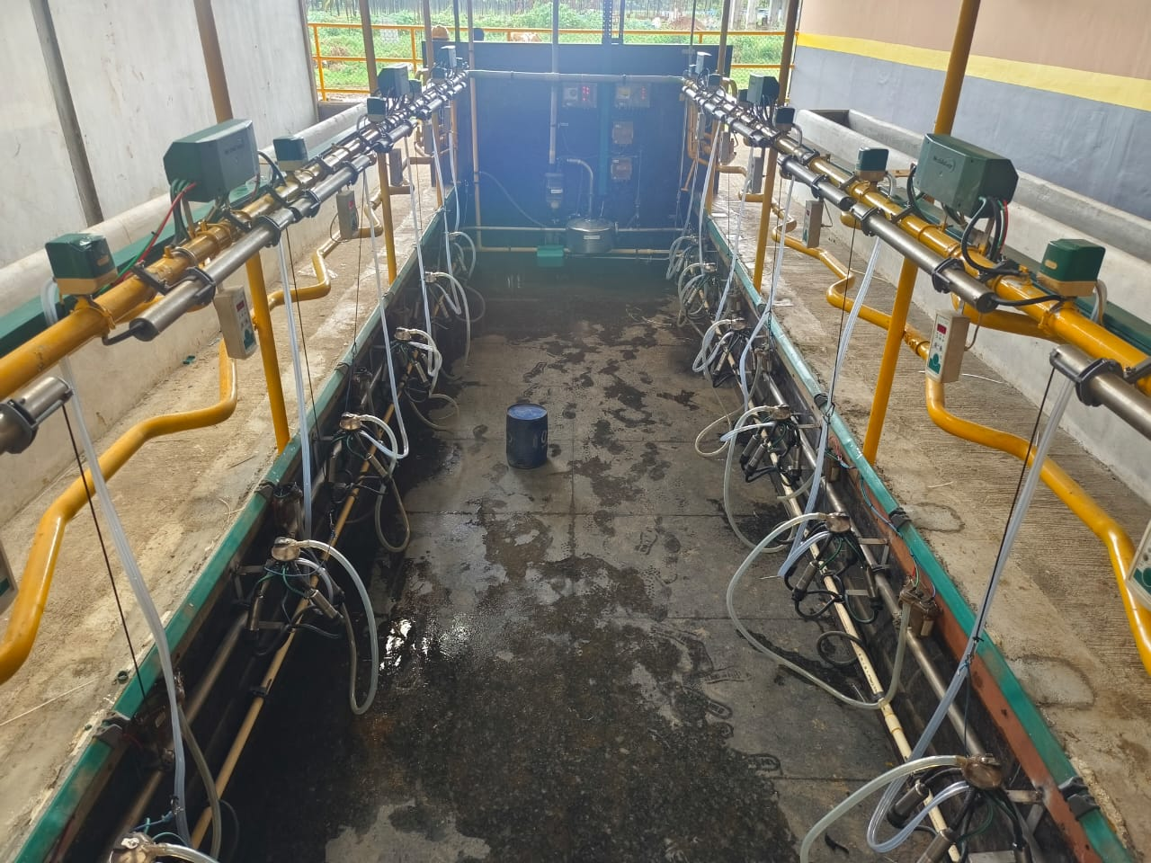
Current condition
Entire milking parlor Installation is complete and parlor is ready for milking

